Slide 1

Sentiment Analysis for Marketing using AI
Learn how AI-powered sentiment analysis can help your marketing efforts by analyzing customer feedback and sentiment towards your brand.

Slide 2
TEAM MEMBERS
1. Mehandhan GH
2. Jagadeesan M
3. Hridai Jain D
4. Gunasekar D

Slide 3

Introduction to Sentiment Analysis
Sentiment analysis is the process of using natural language processing, text analysis, and computational linguistics to identify and extract subjective information from text data. This information can be used to determine the overall sentiment of a particular piece of content, such as a social media post or customer review.
Why Use AI for Sentiment Analysis in Marketing?
AI-powered sentiment analysis allows marketers to quickly and accurately analyze large amounts of customer feedback, including social media posts, online reviews, and customer service interactions. This information can help companies gain valuable insights into customer preferences, pain points, and overall satisfaction levels, which can inform product development, marketing campaigns, and customer service strategies.

Slide 4
Why Use AI for Sentiment Analysis in Marketing?
Efficiency and Accuracy:
AI-powered sentiment analysis can analyze large amounts of data in a shorter amount of time and with higher accuracy compared to human analysis.
Real-Time Monitoring:
AI-powered sentiment analysis can monitor social media and other online platforms in real-time, allowing companies to respond quickly to negative sentiment and address customer concerns.
Insights and Actionable Data:
AI-powered sentiment analysis can provide valuable insights and actionable data for businesses to make informed decisions about their marketing strategies.

Slide 5
How Sentiment Analysis Works?
Sentiment analysis, also known as opinion mining, is the process of using natural language processing (NLP) and machine learning techniques to identify and extract subjective information from text data. The goal of sentiment analysis is to determine the emotional tone behind a piece of writing, whether it is positive, negative, or neutral.
The process of sentiment analysis involves several steps:
Data Collection
Text Processing
Feature Extraction
Machine Learning
Visualize Result
Sentiment Classification

Slide 6
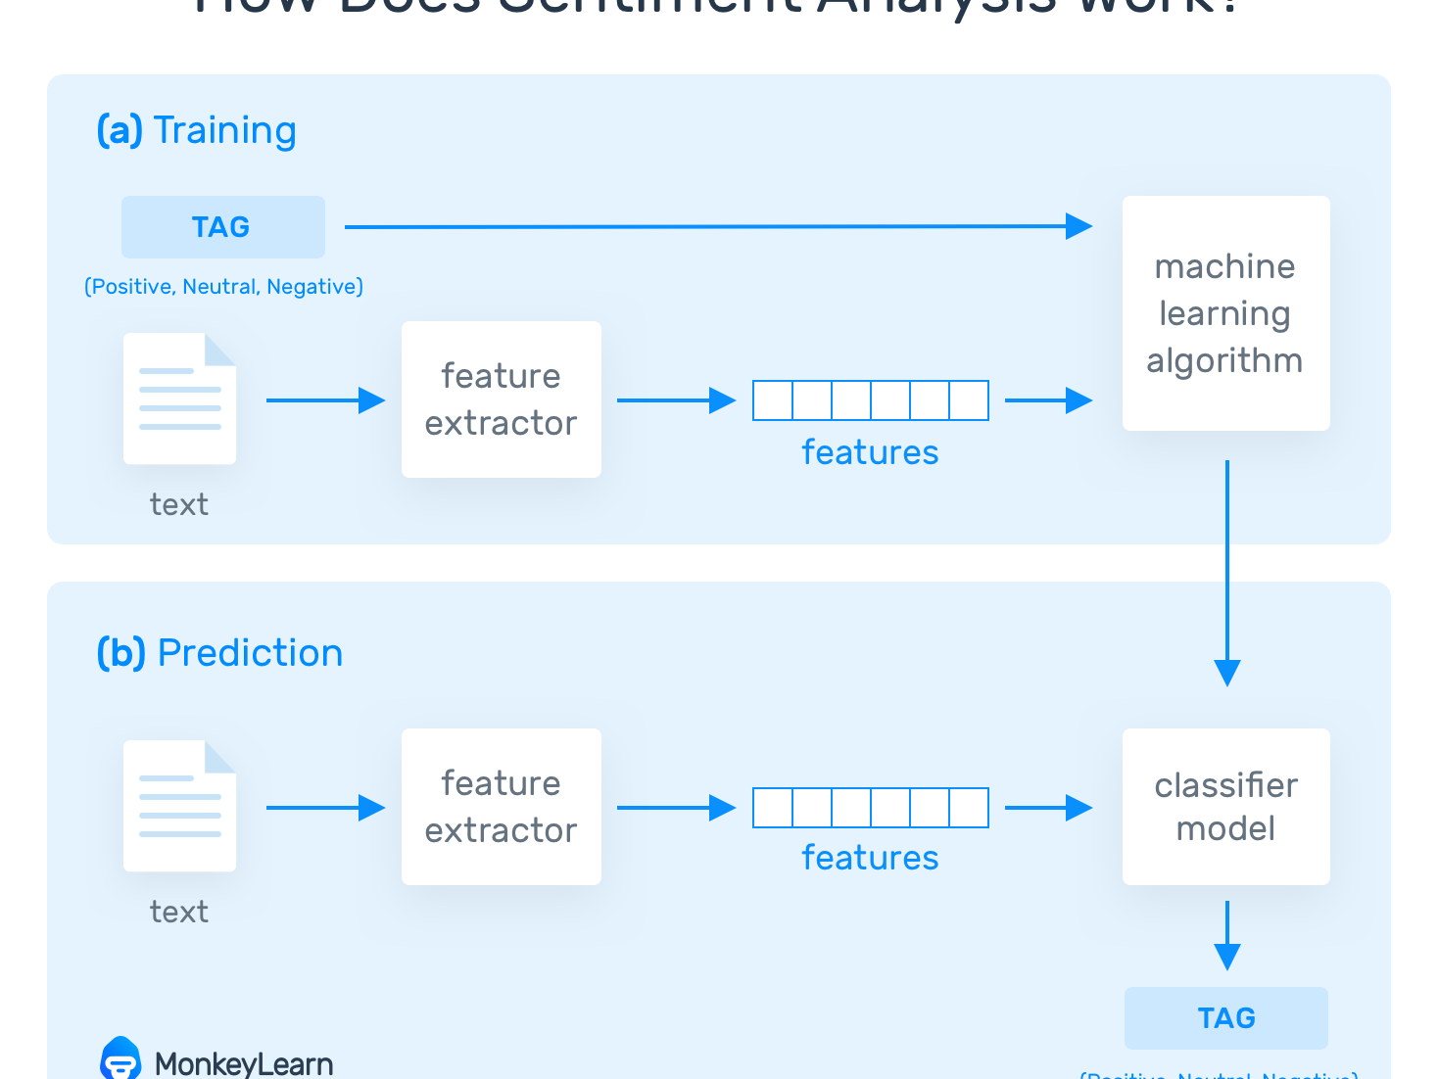
Working Of Sentiment Analysis

Slide 7
Data Collection
Social Media Monitoring :
Sentiment analysis can be used to monitor social media channels for mentions of a brand or product, and to gauge the overall sentiment around them. This can help companies identify potential issues and address them before they become major problems, as well as track the success of marketing campaigns.
Product Development :
By analyzing customer feedback on social media and other platforms, companies can gain insights into customer preferences and identify opportunities for new product development or improvements to existing products.
Data Analysis Techniques :
Once the data is collected, it can be analyzed using various techniques such as text mining, natural language processing, and machine learning algorithms. These techniques can help in identifying patterns and trends in customer sentiment, which can be used to improve marketing strategies and customer experience.

Slide 8
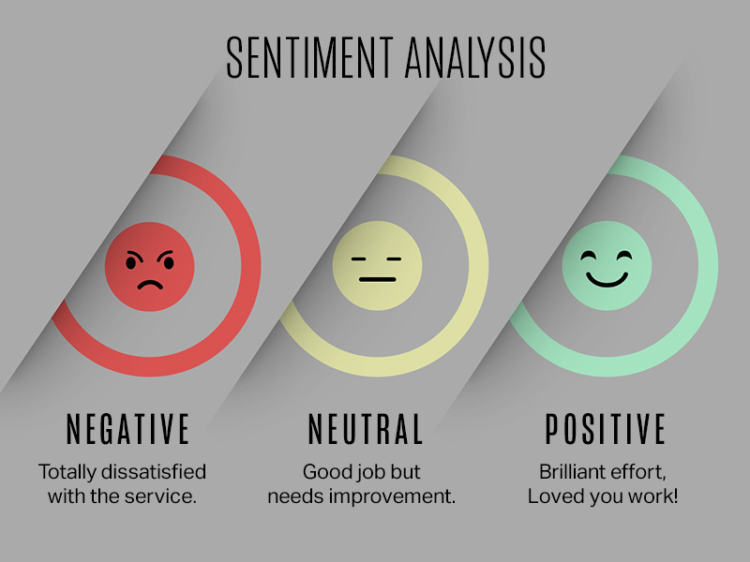
Text Processing
Text analysis for finding emotions, often referred to as sentiment analysis or emotion analysis, is a natural language processing (NLP) technique that aims to determine and quantify the emotional tone, sentiment, or mood expressed within a piece of text. This could be in the form of a sentence, paragraph, document, or even a social media post.
Raw Text: This is the unprocessed, original text data. It consists of sentences, paragraphs, or documents that may contain unstructured information in natural language. Raw text can come from various sources such as books, articles, websites, social media posts, emails, and more.
Tokens: Text is typically divided into smaller units called tokens, which are often words or phrases. Tokenization is the process of splitting raw text into these units, making it easier to analyse and process.
Word Frequency: Information about the frequency of individual words in a text document. This data is often used for tasks like keyword extraction, topic modelling, and identifying common terms.

Slide 9
Feature Extracting
In sentiment analysis, feature extraction is a crucial step that involves transforming the raw text data into a format that machine learning algorithms can work with. The goal is to represent text data in a numerical or vectored form, which captures the relevant information for sentiment classification
Bag of Words (BoW):
In BoW representation, each document is represented as a vector of word frequencies.
The vocabulary is constructed from all unique words in the entire dataset.
Features are binary (0 or 1) or can represent the frequency of each word in the document.
It is a simple and interpretable method but does not capture word order or context.
Term Frequency-Inverse Document Frequency (TF-IDF):
TF-IDF is a more advanced feature extraction technique.
It assigns a weight to each word based on its frequency in a specific document and its inverse frequency across all documents.
It helps highlight important words that are specific to a document but not common across the entire dataset.
Word Embedding:
Word embedding are dense vector representations of words in a continuous space.
These embedding's capture semantic relationships between words and are often pre-trained on extensive text data.
You can average or concatenate word embedding's to represent documents.

Slide 10
Machine Learning
Naive Bayes:
Naive Bayes classifiers are simple and effective for text classification tasks like sentiment analysis.
They are based on Bayes' theorem and assume that features (words in this case) are conditionally independent.
Multinomial Naive Bayes is often used for text data.
Support Vector Machines (SVM):
SVMs are powerful for binary and multiclass text classification tasks.
They aim to find a hyper plane that maximizes the margin between different sentiment classes.
SVMs can use various kernel functions, such as linear, polynomial, or radial basis function (RBF), to handle non-linear data.
Recurrent Neural Networks (RNNs):
RNNs, especially Long Short-Term Memory (LSTM) and Gated Recurrent Unit (GRU) variants, can model sequential data effectively.
They are suitable for sentiment analysis tasks where word order and context matter.
RNNs can capture long-range dependencies in text.
Convolutional Neural Networks (CNNs):
CNNs are mainly used for image classification but can be adapted for text classification.
They are effective at capturing local features and can be used for tasks like sentiment analysis on short text snippets.

Slide 11
Visualising The Results
1. Bar Charts:
A simple bar chart can show the distribution of sentiments (positive, negative, neutral) in a dataset or a specific set of documents
Each sentiment category is represented by a bar, and the height of the bar indicates the frequency or proportion of documents in that category.
2. Pie Charts:
Pie charts can be used to display the percentage breakdown of different sentiment categories in a dataset.
They provide a clear visual representation of the overall sentiment distribution.
3. Line Charts or Time Series:
In cases where sentiment analysis is performed over time, a line chart can be used to show how sentiments change over a period.
This is particularly useful for monitoring sentiment trends in social media or news articles.
4. Heat maps:
Heat maps can visualize sentiment scores across a set of documents or topics.
Rows represent documents or topics, and columns represent sentiment categories or sentiments.
The intensity of colour (e.g., from cool to warm colours) can represent sentiment strength.

Slide 12
Sentiment Classification
In sentiment analysis for marketing, sentiment classifications are used to understand and categorize the emotional tone or sentiment expressed in customer feedback, reviews, comments, and social media posts related to products, brands, or marketing campaigns.
Positive Sentiment:
This category represents favourable or positive emotions expressed by customers or users.
Examples include expressions of satisfaction, delight, joy, and enthusiasm.
Positive sentiment can indicate that customers are happy with a product or marketing campaign.
Negative Sentiment:
Negative sentiment signifies dissatisfaction, disappointment, frustration, or other negative emotions.
It often indicates areas where products or marketing efforts need improvement.
Negative sentiment can be crucial for identifying issues and addressing customer concerns.
Neutral Sentiment:
Neutral sentiment represents a lack of strong positive or negative emotions.
It can indicate a neutral or factual tone in the text without a clear emotional bias.
In marketing, neutral sentiment may be used when customers provide factual information or descriptions without expressing strong opinions.
Mixed Sentiment:
Mixed sentiment refers to cases where both positive and negative sentiments are expressed within the same piece of text.
It is essential to recognize mixed sentiment to capture nuanced feedback accurately.
Identifying mixed sentiment can help identify areas for improvement while acknowledging areas of satisfaction.

Slide 13
Conclusion
Sentiment analysis is a valuable natural language processing (NLP) technique that holds significant importance across various industries and applications. In conclusion, sentiment analysis:
Provides Customer Insights: It allows businesses to gain a deep understanding of customer opinions, emotions, and sentiments expressed in text data, including reviews, social media posts, and customer feedback. This insight is instrumental in improving products and services, enhancing customer experiences, and making data-driven decisions.
Enhances Marketing Strategies: Sentiment analysis helps marketers gauge the effectiveness of their campaigns, monitor brand perception, and identify trends in customer sentiment. By analyzing sentiment trends over time, marketers can fine-tune their strategies and tailor their messaging to resonate with their target audience.

